Slide 1
Presentation on GSM

Slide 2
Contents
• GSM-Introduction
• Architecture
• Technical Specifications
Characteristics and features

Slide 3
What is GSM ?
Global System for Mobile (GSM) is a second generation cellular standard developed to cater voice services and data delivery using digital modulation

Slide 4
GSM Services
Tele-services
Bearer or Data Services
Supplementary services

Slide 5
Tele Services
• Telecommunication services that enable voice communication
via mobile phones
• Offered services
- Mobile telephony
- Emergency calling

Slide 6
Bearer Services
Include various data services for information transfer between GSM and other networks like PSTN, ISDN etc at rates from 300 to 9600 bps
Short Message Service (SMS)
  up to 160 character alphanumeric data transmission to/from the mobile terminal
Unified Messaging Services(UMS)
Group 3 fax
Voice mailbox
Electronic mail

Slide 7
Supplementary Services
Call related services :
Call Waiting- Notification of an incoming call while on the handset
Call Hold- Put a caller on hold to take another call
Call Barring- All calls, outgoing calls, or incoming calls
Call Forwarding- Calls can be sent to various numbers defined by the user
Multi Party Call Conferencing - Link multiple calls together
CLIP – Caller line identification presentation
CLIR – Caller line identification restriction
CUG – Closed user group

Slide 8
GSM System Architecture
PSTN
ISDN
PDN
BSC
MS
BTS
MSC
GMSC
BTS
BSC
VLR
MS
BTS
EIR
AUC
MS
HLR

Slide 9
GSM System Architecture-I
Mobile Station (MS)
    Mobile Equipment (ME)
    Subscriber Identity Module (SIM)
Base Station Subsystem (BSS)
    Base Transceiver Station (BTS)
    Base Station Controller (BSC)
Network Switching Subsystem(NSS)
    Mobile Switching Center (MSC)
    Home Location Register (HLR)
    Visitor Location Register (VLR)
    Authentication Center (AUC)
    Equipment Identity Register (EIR)

Slide 10
System Architecture
Mobile Station (MS)
The Mobile Station is made up of two entities:
Mobile Equipment (ME)
2. Subscriber Identity Module (SIM)

Slide 11
System Architecture
Mobile Station (MS)
Mobile Equipment
Portable,vehicle mounted, hand held device
Uniquely identified by an IMEI (International Mobile Equipment Identity)
Voice and data transmission
Monitoring power and signal quality of surrounding cells for optimum handover
Power level : 0.8W – 20 W
160 character long SMS.

Slide 12
System Architecture
Mobile Station (MS) contd.
Subscriber Identity Module (SIM)
Smart card contains the International Mobile Subscriber Identity (IMSI)
Allows user to send and receive calls and receive other subscribed services
Encoded network identification details
- Key Ki,Kc and A3,A5 and A8 algorithms
Protected by a password or PIN
Can be moved from phone to phone – contains key information to activate the phone

Slide 13
System Architecture
Base Station Subsystem (BSS)
Base Station Subsystem is composed of two parts that communicate across the standardized Abis interface allowing operation between components made by different suppliers
Base Transceiver Station (BTS)
Base Station Controller (BSC)

Slide 14
System Architecture
Base Station Subsystem (BSS)
Base Transceiver Station (BTS):
Encodes,encrypts,multiplexes,modulates and feeds the RF signals to the antenna.
Frequency hopping
Communicates with Mobile station and BSC
Consists of Transceivers (TRX) units

Slide 15
System Architecture
Base Station Subsystem (BSS)
Base Station Controller (BSC)
Manages Radio resources for BTS
Assigns Frequency and time slots for all MS’s in its area
Handles call set up
Transcoding and rate adaptation functionality
Handover for each MS
Radio Power control
It communicates with MSC and BTS

Slide 16
System Architecture
Network Switching Subsystem(NSS)
Mobile Switching Center (MSC)
Heart of the network
Manages communication between GSM and other networks
Call setup function and basic switching
Call routing
Billing information and collection
Mobility management
- Registration
- Location Updating
MSC does gateway function while its customer roams to other network by using HLR/VLR.

Slide 17
System Architecture
Network Switching Subsystem
Home Location Registers (HLR)
    - permanent database about mobile subscribers in a large service area(generally one per GSM network operator)
    database contains IMSI,MSISDN,prepaid/postpaid,roaming restrictions,supplementary services.
Visitor Location Registers (VLR)
    Temporary database which updates whenever new MS enters its area, by HLR database
    Controls those mobiles roaming in its area
    Reduces number of queries to HLR
    Database contains IMSI,TMSI,MSISDN,MSRN,Location Area,authentication key

Slide 18
System Architecture
Network Switching Subsystem
Authentication Center (AUC)
    Protects against intruders in air interface
    Maintains authentication keys and algorithms and provides security triplets ( RAND,SRES,Kc)
    Generally associated with HLR
Equipment Identity Register (EIR)
    - Database that is used to track handsets using the IMEI (International Mobile Equipment Identity)
    Made up of three sub-classes: The White List, The Black List and the Gray List
    Only one EIR per PLMN

Slide 19
GSM Specifications-1
RF Spectrum
GSM 900
Mobile to BTS (uplink): 890-915 Mhz
BTS to Mobile(downlink):935-960 Mhz
Bandwidth : 2* 25 Mhz
GSM 1800
Mobile to BTS (uplink): 1710-1785 Mhz
BTS to Mobile(downlink) 1805-1880 Mhz
Bandwidth : 2* 75 Mhz

Slide 20
GSM Specification-II
No. of RF carriers : 128
Access Method : TDMA/FDMA
Modulation Method : GMSK
Modulation data rate : 270.833 Kbps

Slide 21
Call Routing
Call Originating from MS
Call termination to MS

Slide 22
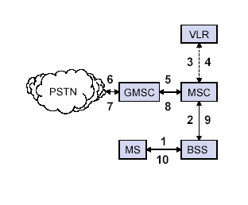
Outgoing Call
MS sends dialled number to BSS
BSS sends dialled number to MSC
3,4 MSC checks VLR if MS is allowed the requested service.If so,MSC asks BSS to allocate resources for call.
MSC routes the call to GMSC
GMSC routes the call to local exchange of called user
7, 8,
9,10 Answer back(ring back) tone is routed from called user to MS via GMSC,MSC,BSS

Slide 23
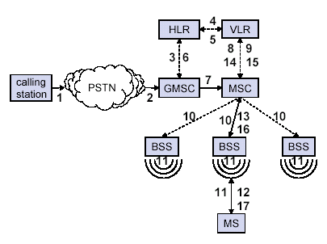
Incoming Call
Calling a GSM subscribers
Forwarding call to GSMC
Signal Setup to HLR
5. Request MSRN from VLR
Forward responsible MSC to GMSC
Forward Call to current MSC
9. Get current status of MS
11. Paging of MS
13. MS answers
15. Security checks
17. Set up connection

Slide 24
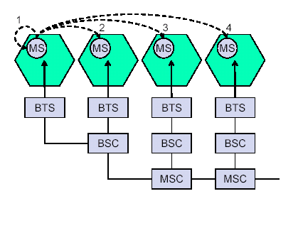
Handovers
Between 1 and 2 – Inter BTS / Intra BSC
Between 1 and 3 –
Inter BSC/ Intra MSC
Between 1 and 4 –
Inter MSC

Slide 25
Characteristics of GSM Standard
Fully digital system using 900,1800 MHz frequency band.
TDMA over radio carriers(200 KHz carrier spacing.
8 full rate or 16 half rate TDMA channels per carrier.
User/terminal authentication for fraud control.
Encryption of speech and data transmission over the radio path.
Full international roaming capability.
Low speed data services (upto 9.6 Kb/s).
Compatibility with ISDN.
Support of Short Message Service (SMS).

Slide 26
Future Of GSM
  2nd Generation
    GSM -9.6 Kbps (data rate)
  2.5 Generation ( Future of GSM)
    HSCSD (High Speed ckt Switched data)
      Data rate : 76.8 Kbps (9.6 x 8 kbps)
    GPRS (General Packet Radio service)
      Data rate: 14.4 - 115.2 Kbps
    EDGE (Enhanced data rate for GSM Evolution)
      Data rate: 547.2 Kbps (max)
  3 Generation
    WCDMA(Wide band CDMA)
      Data rate : 0.348 – 2.0 Mbps

Slide 27
Thanks !

Slide 28
Questions ?

